Slide 1
METRO MANILA FEDERATION OF CONSUMERS COOPERATIVES
(MMAFECCO)

Slide 2
Activities for 2013-2014
Updates on Philippine Co-operatives
Activities of MMAFECCO
Challenges faced by MMAFECCO and University Co-operatives
Strategies Adopted to Counter the Challenges
Plans for the Future

Slide 3
I. Updates on Philippine Co-operatives
Total Number of Registered Co-operatives, as of Dec. 31, 2013
REGION | ADVOCACY | AGRARIAN REFORM | CONSUMER | COOP BANK-SECONDARY | CREDIT | DAIRY | EDUCATION | ELECTRIC | FEDERATION-SECONDARY | FEDERATION-TERTIARY | FINANCIAL SERVICE | FISHERMEN | HEALTH SERVICES
GRAND TOTAL | 22 | 66 | 1,266 | 46 | 2,959 | 28 | 3 | 4 | 204 | 6 | 3 | 35 | 2
REGION | HOUSING | INSURANCE - SECONDARY | MARKETING | MULTI-PURPOSE | PRODUCER | SERVICE | TRANSPORT | UNION-SECONDARY | UNION-TERTIARY | WATER | WORKERS | GRAND TOTAL
GRAND TOTAL | 20 | 4 | 1,178 | 14,722 | 1,624 | 1,316 | 73 | 56 | 1 | 4 | 30 | 23,672

Slide 4
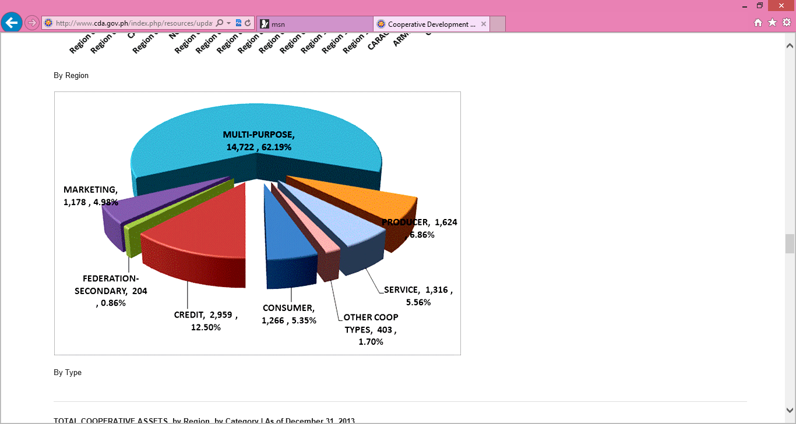
I. Updates on Philippine Co-operatives
Total Number of Registered Co-operatives, as of Dec. 31, 2013 20133

Slide 5
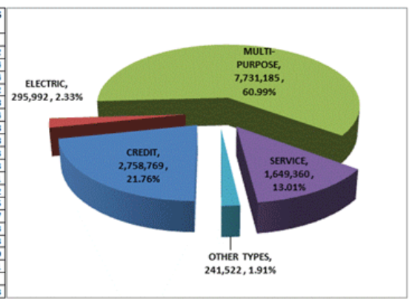
I. Updates on Philippine Co-operatives
Total Co-operative Membership, as of Dec. 31, 2013
Type of Co-operative | Total No. of Registered Co-operatives | Total Membership | Average Members Per Co-operative
Grand Total | 23,355 | 12,676,828 | 543

Slide 6
I. Updates on Philippine Co-operatives
Total Volume of Business, as of Dec. 31, 2013
Region | Total No. of Registered Co-operatives | Total Volume of Business
Grand Total | 23,672 | 437,612,143,697.44
Employment Generated by Co-operatives, as of Dec. 31, 2013
Region | Total No. of Registered Co-operatives | Total No. of Employees | Average Employees per Co-operative
Grand Total | 23,672 | 259,527 | 11

Slide 7
I. Updates on Philippine Co-operatives
Co-operative Contribution to Gross Domestic Product, FY 2012
Region | 2012 Co-operative Gross Regional Domestic Product (in thousand pesos) | 2012 Philippine Gross Regional Domestic Product (in thousand pesos) | Co-operative Contribution to GDP
Grand Total | 307,375,283 | 6,311,670,842 | 4.87%

Slide 8
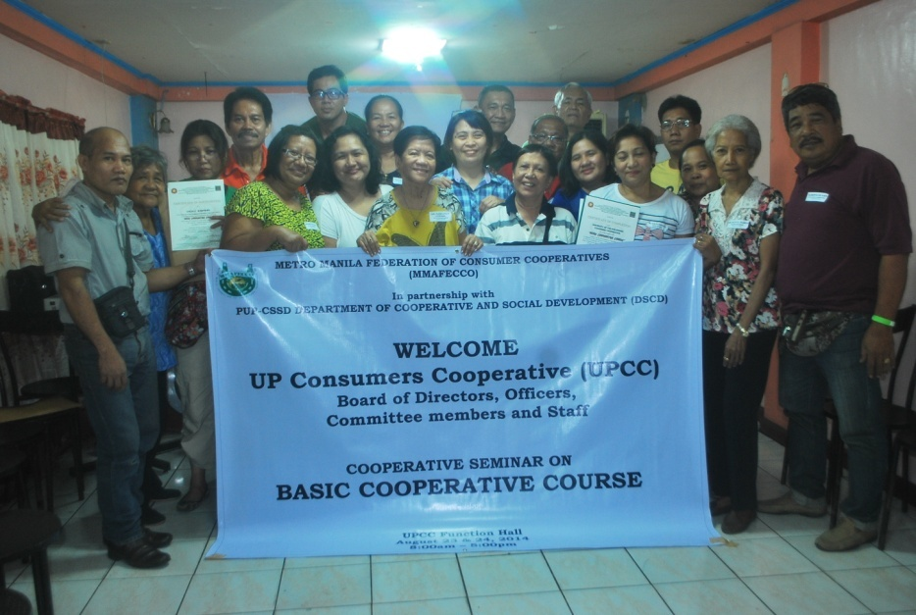
II. Activities of MMAFECCO
1.continuous training given to member
co-operatives - these trainings are required by the Co-operative Development Authority for BOD, managers, committees and staff

Slide 9
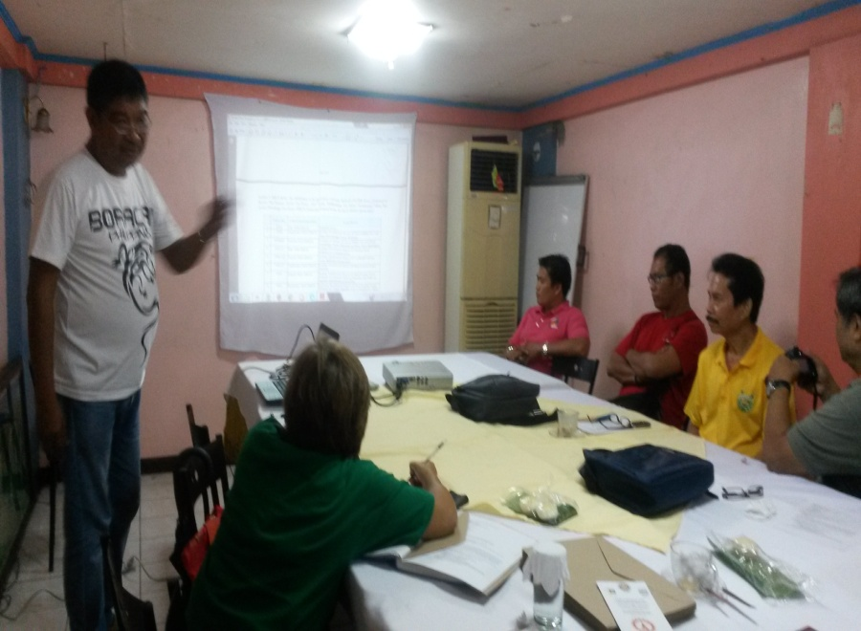
II. Activities of MMAFECCO
2. livelihood seminars for co-operative members: making of detergents, hand sanitizers, fabric conditioners
3. seminar on the new guidelines on
co-operative taxation

Slide 10
II. Activities of MMAFECCO
4. regular visitation to member co-operatives - discussion with BOD and managers on:
a. how to efficiently and effectively
manage the co-operative
b. determination of co-operative
concerns and how to address them

Slide 11
II. Activities of MMAFECCO
5. tie-up with the Manila Water
Foundation
the Manila Water Company is the sole
provider of water and waste water
services in East Metro Manila
the company put up the Manila Water
Foundation to provide co-operatives
with a Php100,000 ($ 2,300) loan,
interest-free, payable in one year.

Slide 12
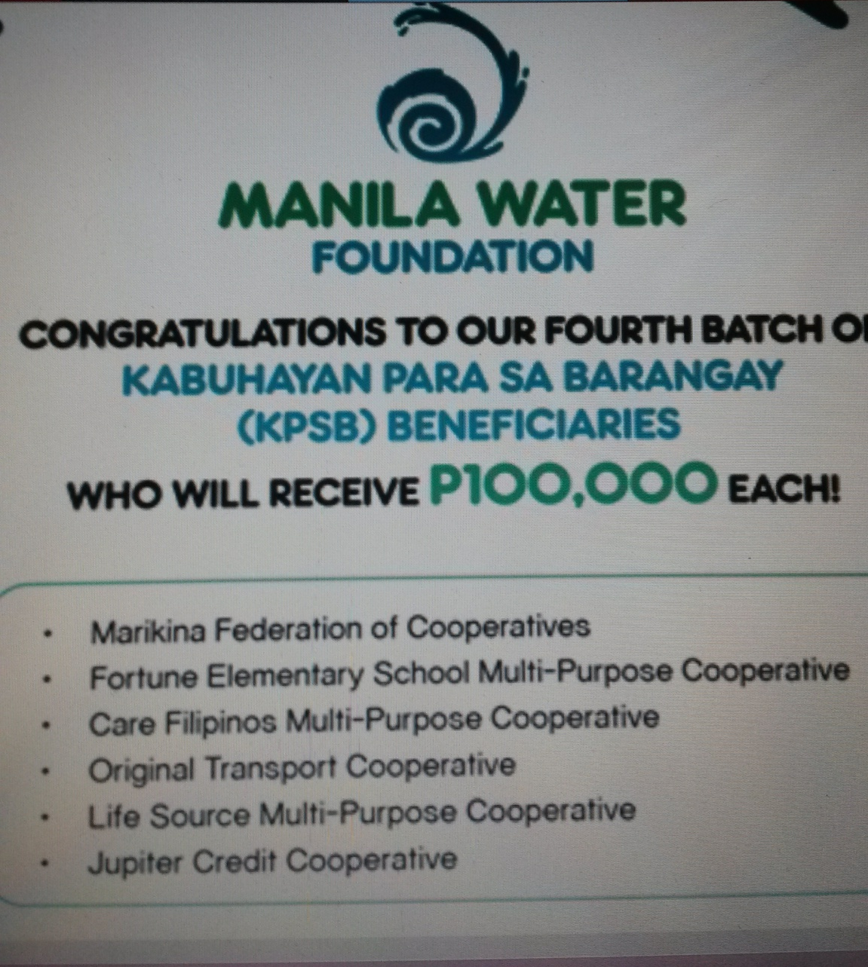
II. Activities of MMAFECCO

Slide 13
II. Activities of MMAFECCO
6. participation in the :
1st Metro Manila Co-operative Congress
  Sept. 26, 2014
  One Esplanade, Pasay City
  Theme: Responding to Co-operative
  Blueprint 2020

Slide 14
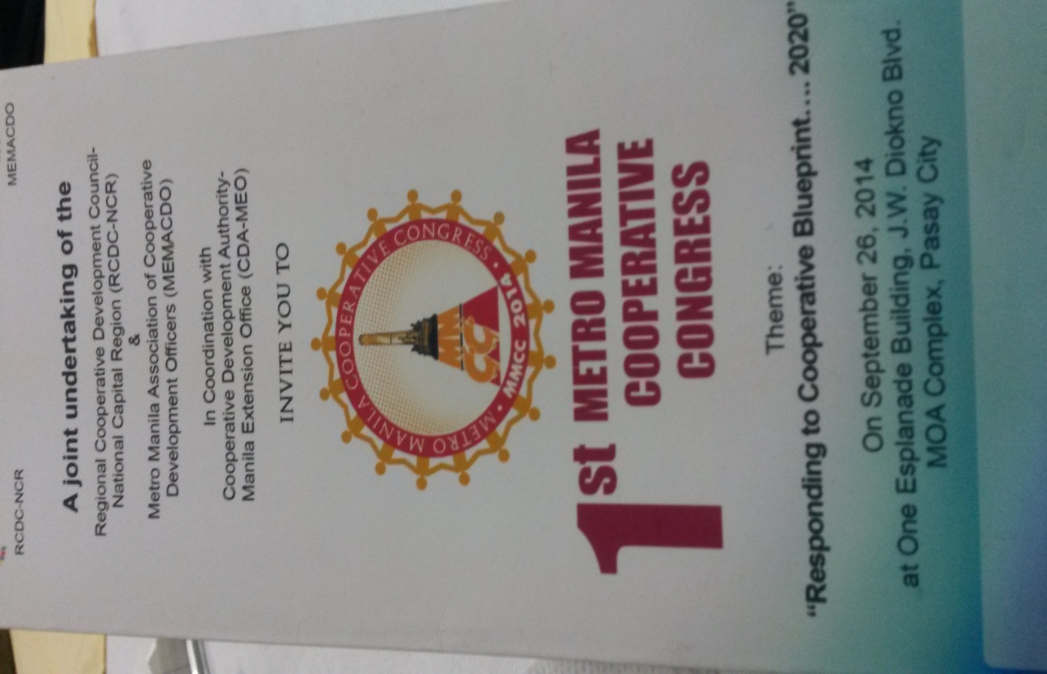
II. Activities of MMAFECCO

Slide 15
II. Activities of MMAFECCO
6. participation in the :
12th National Co-operative Summit
  Oct. 16-18, 2014
  Waterfront Hotel, Cebu City
  Theme: CO-OPS 2020: Raising the Bar

Slide 16

II. Activities of MMAFECCO

Slide 17
III. Challenges faced by MMAFECCO and University Co-operatives
1. competition posed by convenience stores, fast food chains, book stores, grocery stores
2. lack of support of some University administration
3. high rent
4. lack of competent managers
5. low salaries of co-operative employees

Slide 18
IV. Strategies Adopted to Counter the Challenges
1. more aggressive marketing strategies
a. more efficient delivery system
b. competitive pricing
c. conduct of trade fairs and bazaars
d. special day sale on Christmas,
Valentine’s Day and other holidays

Slide 19
IV. Strategies Adopted to Counter the Challenges
e. awards to be given to top purchasers
f. dialogue with university administration
g. continuous training of managers and
staff

Slide 20
V. Plans for the Future
diversification to other forms of businesses: travel/ tour, dormitory, gasoline station, pre-school
partnership with more producers/ manufacturers co-operatives
establishment of a stronger linkage with farmers/ agricultural co-operatives
-their products are marketed to the members of MMAFECCO

Slide 21
Coming together is a beginning.
Keeping together is progress.
Working together is success.
- Henry Ford

Slide 22
Let us all continue working together for the growth and development of
co-operatives in our region and in the world.
THANK YOU VERY MUCH!
Zeny Diola Sept. 17, 2014
MMAFECCO Bali, Indonesia
Philippines

